Slide 1
2016 Annual Member Meeting
Washington DC

Slide 2
Activities
Beautiful Journey, Endless Friendship
Opening of Peace Corps exhibit at the Museum of Contemporary Korean History

Slide 3
Activities
Korea Foundation grant to create a study guide to accompany the DVD, ‘The Korean Transformation’

Slide 4
Board Elections
2nd year of new process
Open nominations process
E-ballot
2016-2017 results
4 new board members
Jenna Gibson
Bruce Kim
Joy Kim
David Roden
Thanks to those who have served
Lynn Barclay
Mary Broude
Paula Ness Speers

Slide 5
2016-2017 Officers
Nancy Kelly – President
Suzanne Crowder Han – Vice President
Gerry Krzic – Vice President
James Mayer – Treasurer
Rob Ichihana - Secretary

Slide 6
Giving Back
3rd year of FOK Giving Back Initiative
Los Angeles, 2014: Korean American Family Services
Boston, 2015: National Association of Korean American Inter-Cultural Family Mission and the Korean American Senior Citizen Association
Washington, DC 2016: Virginia Korean American Disabled People’s Association

Slide 7
Membership
Lifetime membership ($250)
Started in 2013, currently 83 members
Annual members ($25)
Currently 58 active members and 60 lapsed
Student members ($10)
Mailing list = 2557

Slide 8
Honorary Membership
New category created in 2015. Nominations can be made by FOK members.
Means of recognizing and thanking those individuals who have supported the mission and activities of FOK.
Nomination form is on website:
http://www.friendsofkorea.net/honorary-membership.html

Slide 9
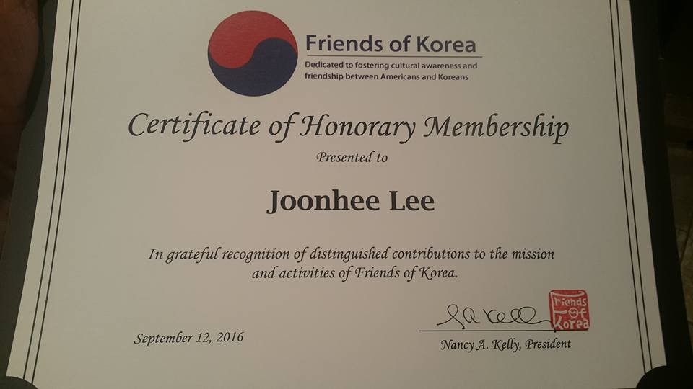
2016 Honorary members
Joonhee Lee
Sunny Kim
Garry Stanberry

Slide 10
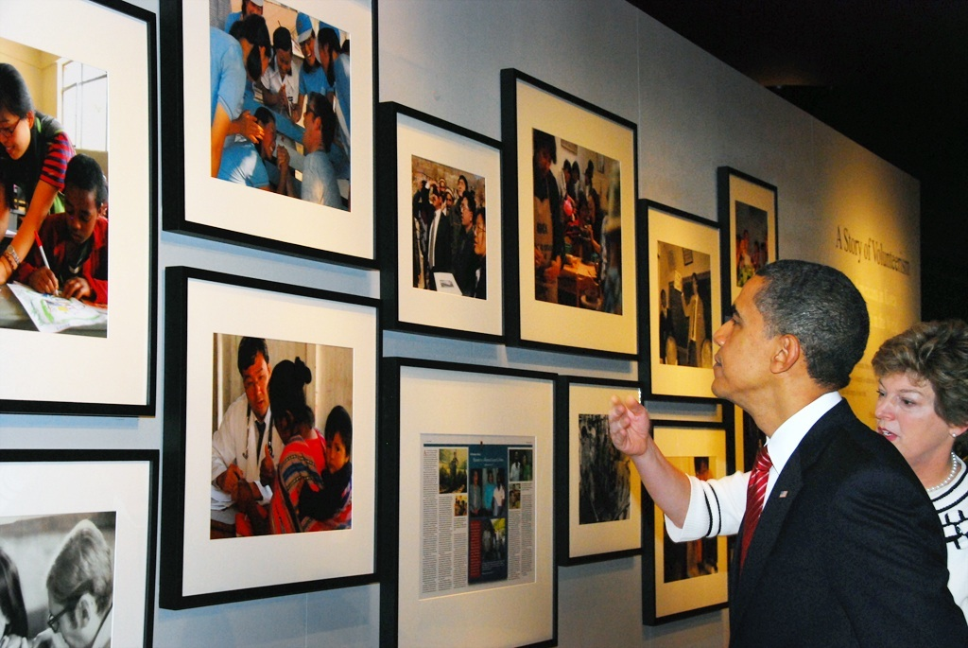
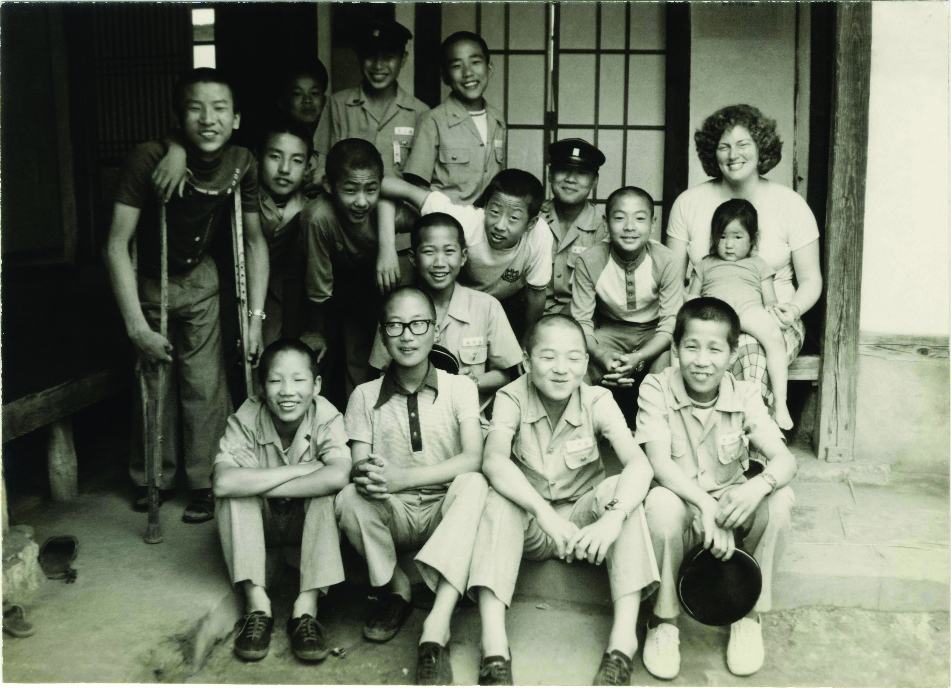
Kevin O’Donnell Award
First honoree is Kathy Stephens
Impressive group of nominees

